Slide 1
ARM Processor - Introduction

Slide 2
Introduction
ARM processor – Reduced Instruction set computer
Originally developed by Acorn Computers Limited of Cambridge
Started in 1983 as a project for Acorn Computers Limited
ARM stood for Acorn RISC Machine
In 1980’s Apple Computer started working with Acorn and the company later known as Advanced RISC Machine
Develops architecture and license it to other companies, who design their own product that implement one of those architecture
Selling IP cores which licensees use to create microcontrollers, CPUs, SoC on their cores
ARM do not make IC, instead grant licenses of core to different Si vendors like ATMEL, NXP, Cirrus Logic
Eg:
LPC2148 from NXP
AT91RM9200 from ATMEL

Slide 3
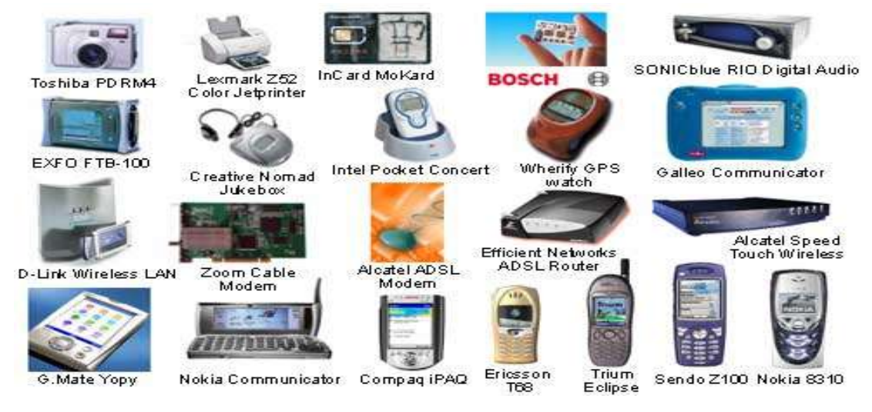
Some products that currently use ARM technology

Slide 4

ARM Partnership Model

Slide 5
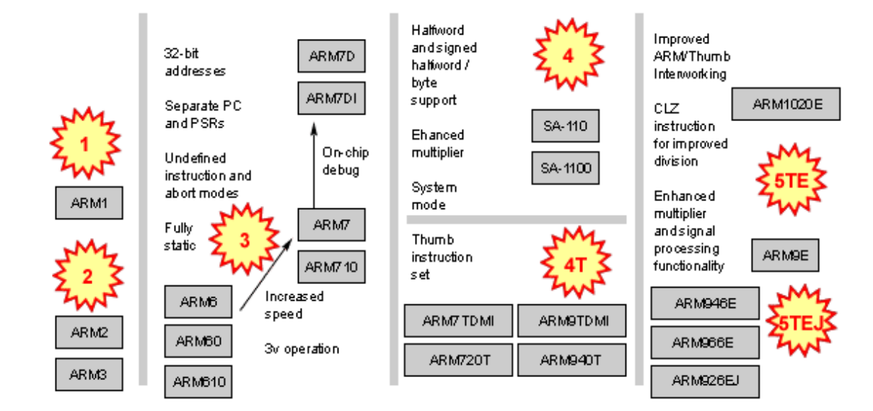
Evolution of the ARM Architecture

Slide 6
Generations of ARM
ARM1
Completed in 1985
ARM2
First “real” production systems
32-bit data bus
26-bit address space
16 32-bit registers
Only 30000 transistors
Did not have microcode
No cache
4 million instructions per seconds
ARM3
32-address space [ for several generations up to ARMv7 remained as 32-bit address space]

Slide 7
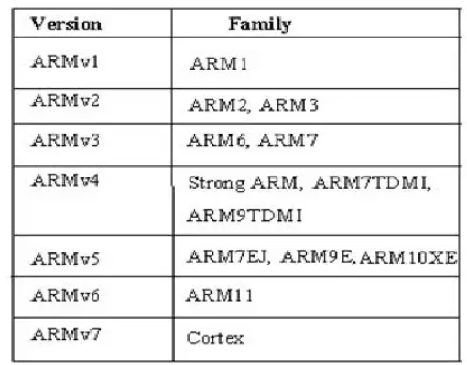
Version 1
26 bit addressing , no multiply or coprocessor.
Version2
Includes 32 bit result multiply coprocessor.
Version3
32 bit addressing.
Version4
add signed, unsigned half-word and signed byte load and store instructions
Version4T
16 bit Thumb compressed form of instruction introduced
Version5T
Superset of 4T adding new instruction
Version 5TE
Add signal processing signal extension

Slide 8
RISC and CISC
RISC
Simpler instruction
Execution time is very less
Smaller set of instructions.
Complex design of compiler.
Few addressing modes & less data types
Simple addressing modes
Can perform register to register operations
Pipelining is possible
Has a hardwired unit
Require less transistors & more general-purpose registers
Cheaper
Not requires external memory for calculations
ARM, AVR, MIPS, PIC etc.
CISC
Complex instruction
Execution time is very high
Larger set of instructions.
Simpler design of compiler
More addressing modes & data types
Complex addressing modes
Can perform memory to memory operations
Pipelining is not possible
Has a microprogramming unit
Require more transistors & less general-purpose registers
Expensive
Requires external memory for calculations
Motorola 68000 family, AMD

Slide 9
CISC vs. RISC
Which is better?
Well, a big debate which can’t be answered so easily!
Because, both are in existence and has not vanished completely.
Major Computer manufacturing firms Apple and Intel have always been arguing on importance of hardware and software in CPU architecture designs.
Intel supporters want the hardware to bear more responsibility and software on the easier side. This would impact the hardware designing to be more complex but software coding would be relatively easy.
On the other hand, Apple supporters want the hardware to be simple and easy and software to take the major role.
Intel’s hardware oriented approach is termed as Complex Instruction Set Computer while that of Apple is Reduced Instruction Set Computer

Slide 10
ARM processor can be divided into 3 categories:
ARM Classic Processor
ARM7, ARM9,ARM11 families
ARM7TDMI- highest shipping 32-bit processor
Arm7 based processor used in many small scale embedded application
ARM Embedded Processor
Used in advanced ARM embedded systems
Cortex-M & Cortex-R processors
Cortex-M : energy efficient, simple to implement
ARM Application Processor
Cortex-A series of processor
Highest performance processors of ARM
Used in powerful mobile devices, network devices etc..

Slide 11
ARM Features
The ARM is a 32-bit architecture.
When used in relation to the ARM:
Byte means 8 bits
Half means 16 bits (two bytes)
Word means 32 bits (four bytes)
Most ARM’s implement two instruction sets for improved code density
32-bit ARM Instruction Set
16-bit Thumb Instruction Set
Jazelle added instruction for directly handling Java byte code
Based upon RISC Architecture with enhancements to meet requirements of embedded applications
Load-store architecture, where data processing operations operate on register contents only.
A large uniform register file
Uniform and fixed length instructions only
32 bit processor
instructions are 32 bit long
Good speed / power consumption
High code density

Slide 12
Enhanced RISC Features
Control over ALU and shifter for every data processing operations to maximize their usage.
Auto increment and decrement addressing modes to optimize program loops
Load and store multiple instructions to maximize data throughput.
Conditional execution of instruction to maximize execution throughput.

Slide 13
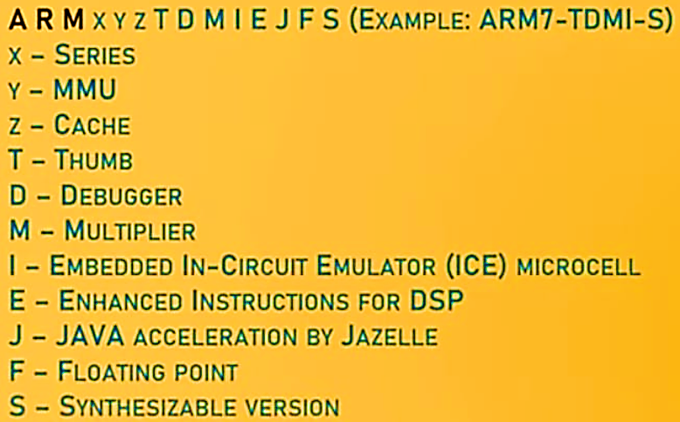
ARM Nomenclature

Slide 14
Where to begin?
Advised to start from LPC214x series
Best processor to begin ARM based application development
LPC214x series – ARM7 based processor with ARM7TDMI-S processor core
Based on ARMv-4 architecture
Introduction of 16-bit Thumb instruction set

Slide 15
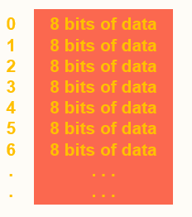
Memory
Viewed as a large, single-dimension array, with an address.
A memory address is an index into the array.
"Byte addressing" means that the index points to a byte of memory.

Slide 16
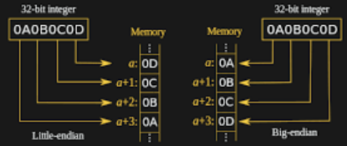
Memory Organization
0
4
8
12
.
.
32 bits of data
32 bits of data
32 bits of data
32 bits of data
…
…
Bytes are nice, but most data items use larger "words"
For ARM, a word is 32 bits or 4 bytes.
2³² bytes with byte addresses from 0 to 2³² – 1
2³⁰ words with byte addresses 0, 4, 8, ... 2³² – 4
Words are aligned i.e., what are the least 2 significant bits of a word address?
Standard little-endian organization

Slide 17
Big Endian and Little Endian
Byte ordering, or endianness, is another major architectural consideration.
If we have a two-byte integer, the integer may be stored so that the least significant byte is followed by the most significant byte or vice versa.
In little endian machines, the least significant byte is followed by the most significant byte.
Big endian machines store the most significant byte first (at the lower address).

Slide 18
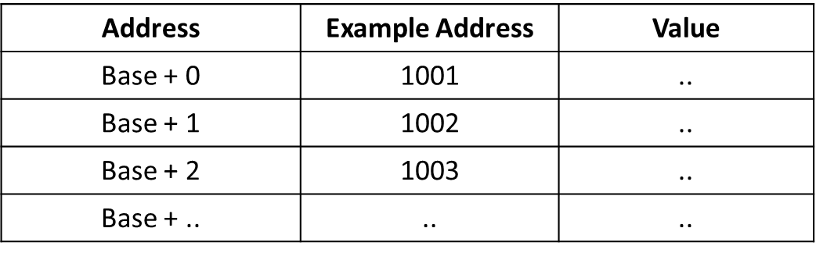

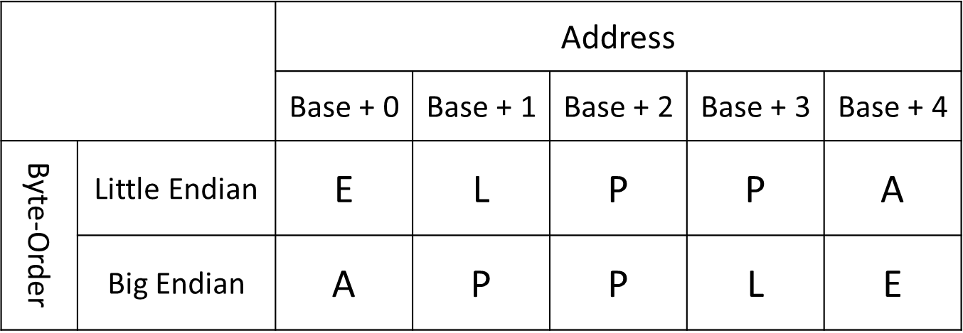
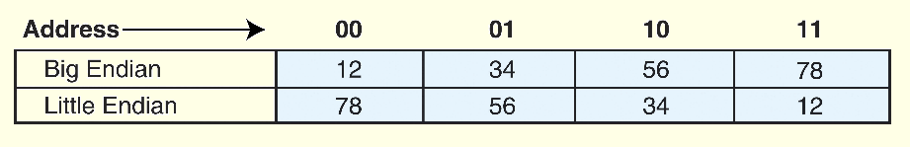
Ex. Represent the String
APPLE

Slide 19
Load-Store Architecture
Instruction set will operate only on registers.
Only memory access:
Copy memory values to registers (load) read
Copy register values to memory (store) write
Unlike in CISC processors, memory-to-memory operations are not supported.

Slide 20
Instruction categories
Data processing instructions
Use and change register values.
Data transfer instructions
Load and store
Control flow instructions
Execution switching

Slide 21
Registers
General purpose registers hold either data or address.
All registers are of 32 bit
In user mode, 16 data registers and 2 status registers are visible.
Data registers :r0 to r15
Three registers r13,r14,r15 perform special functions
r13 stack pointer
r14 link register (where return address is put whenever a subroutine is called)
r15 program counter

Slide 22
Registers
Depending upon context, r13 and r14 can also be used as GPR.
Any instruction which use r0 can be used with any other GPR(r1-r13).
In addition, there are two status registers,
CPSR :Current program status register
SPSR: Saved program status register
PC (r15) value is stored in bits [31:2] with [1:0] bits undefined

Slide 23

ARM: Execution States
When the processor is executing in ARM state:
All instructions are 32 bits wide
All instructions must be word aligned
When the processor is executing in Thumb state:
All instructions are 16 bits wide
All instructions must be halfword aligned
When the processor is executing in Jazelle state:
All instructions are 8 bits wide
Processor performs a word access to read 4 instructions at once
Notes:
ARM is designed to efficiently access memory using a single memory access cycle. So word accesses must be on a word address boundary, halfword accesses must be on a halfword address boundary. This includes instruction fetches.
Point out that strictly, the bottom bits of the PC simply do not exist within the ARM core - hence they are ‘undefined’. Memory system must ignore these for instruction fetches.
In Jazelle state, the processor doesn’t perform 8-bit fetches from memory. Instead it does aligned 32-bit fetches (4-byte prefetching) which is more efficient. Note we don’t mention the PC in Jazelle state because the ‘Jazelle PC’ is actually stored in r14 - this is technical detail that is not relevant as it is completely hidden by the Jazelle support code.

Slide 24
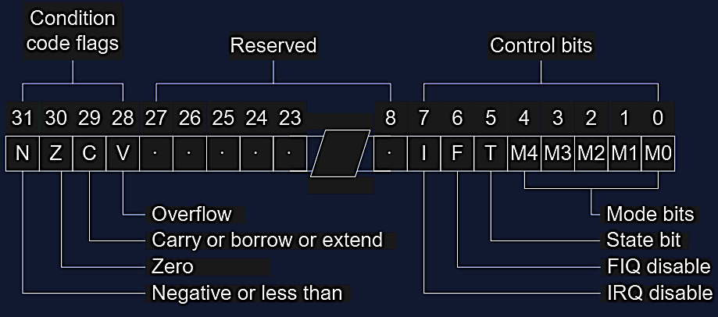
Current Program Status Registers
Condition code flags
N = Negative result from ALU
Z = Zero result from ALU
C = ALU operation Carried out
V = ALU operation oVerflowed
Sticky Overflow flag - Q flag
Architecture 5TE/J only
Indicates if saturation has occurred
J bit
Architecture 5TEJ only
J = 1: Processor in Jazelle state
Interrupt Disable bits.
I = 1: Disables the IRQ.
F = 1: Disables the FIQ.
T Bit
Architecture xT only
T = 0: Processor in ARM state
T = 1: Processor in Thumb state
Mode bits
Specify the processor mode
Notes:
Green psr bits are only in certain versions of the ARM architecture
ALU status flags (set if "S" bit set, implied in Thumb state).
Sticky overflow flag (Q flag) is set either when
saturation occurs during QADD, QDADD, QSUB or QDSUB, or
the result of SMLAxy or SMLAWx overflows 32-bits
Once flag has been set can not be modified by one of the above instructions and must write to CPSR using MSR instruction to cleared
PSRs split into four 8-bit fields that can be individually written:
Control (c) bits 0-7
Extension (x) bits 8-15 Reserved for future use
Status (s) bits 16-23 Reserved for future use
Flags (f) bits 24-31
Bits that are reserved for future use should not be modified by current software. Typically, a read-modify-write strategy should be used to update the value of a status register to ensure future compatibility. Note that the T/J bits in the CPSR should never be changed directly by writing to the PSR (use the BX/BXJ instruction to change state instead).
However, in cases where the processor state is known in advance (e.g. on reset, following an interrupt, or some other exception), an immediate value may be written directly into the status registers, to change only specific bits (e.g. to change mode).
New ARM V6 bits now shown.

Slide 25
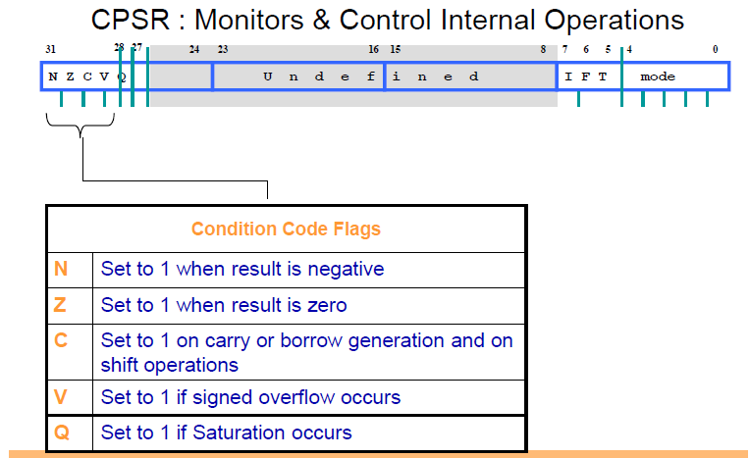
Current Program Status Registers

Slide 26
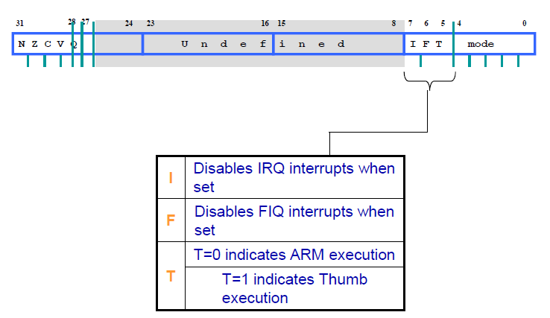
Current Program Status Registers

Slide 27
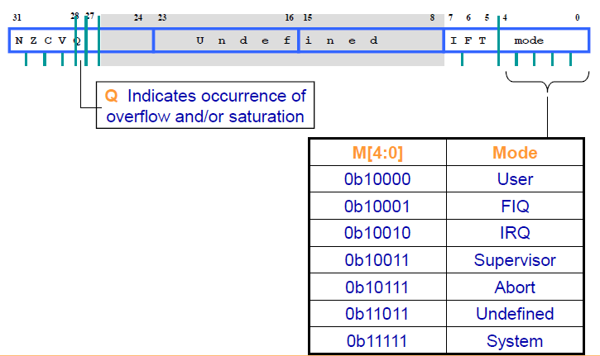
Current Program Status Registers

Slide 28
Processor Modes
The ARM has seven basic operating modes:
User: unprivileged mode under which most tasks run
FIQ: entered when a high priority (fast) interrupt is raised
IRQ: entered when a low priority (normal) interrupt is raised
Supervisor : entered on reset and when a Software Interrupt
instruction is executed
Abort: used to handle memory access violations
Undef : used to handle undefined instructions
System: privileged mode using the same registers as user mode
Notes:
The Programmers Model can be split into two elements - first of all, the processor modes and secondly, the processor registers. So let’s start by looking at the modes.
Now the typical application will run in an unprivileged mode know as “User” mode, whereas the various exception types will be dealt with in one of the privileged modes : Fast Interrupt, Supervisor, Abort, Normal Interrupt and Undefined (and we will look at what causes each of the exceptions later on).
NB - spell out the word FIQ, otherwise you are saying something rude in German!
One question here is what is the difference between the privileged and unprivileged modes? Well in reality very little really - the ARM core has an output signal (nTRANS on ARM7TDMI, InTRANS, DnTRANS on 9, or encoded as part of HPROT or BPROT in AMBA) which indicates whether the current mode is privileged or unprivileged, and this can be used, for instance, by a memory controller to only allow IO access in a privileged mode. In addition some operations are only permitted in a privileged mode, such as directly changing the mode and enabling of interrupts.
All current ARM cores implement system mode (added in architecture v4). This is simply a privileged version of user mode. Important for re-entrant exceptions because no exceptions can cause system mode to be entered.

Slide 29
Processor Modes
Processor Modes determines
Which registers are Active
Access Rights to CPSR Register itself
Each Processor Mode is either
Privileged :
• Full Read-Write access to the CPSR
Non-Privileged :
Only Read access to the Control Field of
CPSR but Read-Write access to the Condition Flags

Slide 30
Processor Modes (2)
ARM has Seven Modes
Privileged :
Abort, Fast Interrupt Request (FIQ), Interrupt Request (IRQ), Supervisor, System & Undefined
Non-Privileged :
• User
User Mode is used for Programs and Applications

Slide 31
Privileged Modes
Abort :
• When there is a failed attempt to access memory
Fast Interrupt Request (FIQ) & Interrupt Request :
Correspond to Interrupt levels available on ARM
Supervisor Mode :
State after Reset and generally the mode in which OS kernel executes

Slide 32
Privileged Modes (2)
System Mode :
Special Version of User Mode that allows Full Read
Write access of CPSR
Undefined :
When the Processor encounters and Undefined Instruction

Slide 33
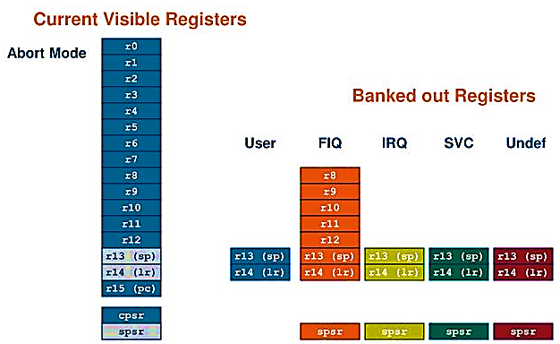
The ARM Register Set
Notes:
This animated slide shows the way that the banking of registers works. On the left the currently visible set of registers are shown for a particular mode.
On the right are the registers that are banked out whilst in that mode.
Each key press will switch mode:
user -> FIQ ->user -> IRQ -> user ->SVC -> User -> Undef -> User -> Abort and then back to user.
The following slide then shows this in a more static way that is more useful for reference

Slide 34
Exception Handling
When an exception occurs, the ARM:
Copies CPSR into SPSR_<mode>
Sets appropriate CPSR bits
Change to ARM state
Change to exception mode
Disable interrupts (if appropriate)
Stores the return address in LR_<mode>
Sets PC to vector address
To return, exception handler needs to:
Restore CPSR from SPSR_<mode>
Restore PC from LR_<mode>
This can only be done in ARM state.
0x1C
FIQ
0x18
IRQ
0x14
(Reserved)
0x10
Data Abort
0x0C
Prefetch Abort
0x08
Software Interrupt
0x04
Undefined Instruction
0x00
Reset
Vector Table
Vector table can be at 0xFFFF0000 on ARM720T and on ARM9/10 family devices

Slide 35
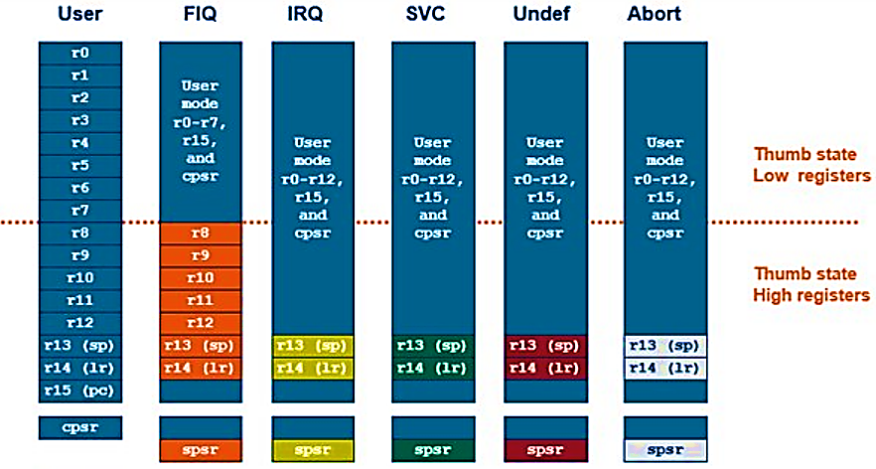
Register Organization Summary
Note: System mode uses the User mode register set
Notes:
This slide shows the registers visible in each mode - basically in a more static fashion than the previous animated slide that is more useful for reference.
The main point to state here is the splitting of the registers in Thumb state into Low and High registers.
ARM register banking is the minimum necessary for fast handling of overlapping exceptions of different types (e.g. ABORT during SWI during IRQ). For nested exceptions of the same type (e.g. re-entrant interrupts) some additional pushing of registers to the stack is required.

